Slide 1

Hospital Appointment Management System
1/5
TERM-II INDIVIDUAL PROJECT
Why this project matters
Priority Scheduling + Smart Slot Suggestion
Eliminates double booking
Fair handling for emergency and senior patients
Manual hospital booking often causes slot clashes, long waits and missed urgent cases. This project automates scheduling while preserving a beginner-friendly, modular Java design.
Core advanced feature
If a higher-priority patient requests an occupied slot, the system books the urgent case first and automatically reschedules the lower-priority booking to the next free slot.
Target users
• Hospital reception staff who book and cancel appointments • Doctors who need conflict-free daily slots • Patients who need faster and fairer booking, especially urgent cases
Beginner-safe
Presentation focus
Flat classes, clear packages, text-file storage
Show one normal booking, one priority conflict and one error case

Slide 2
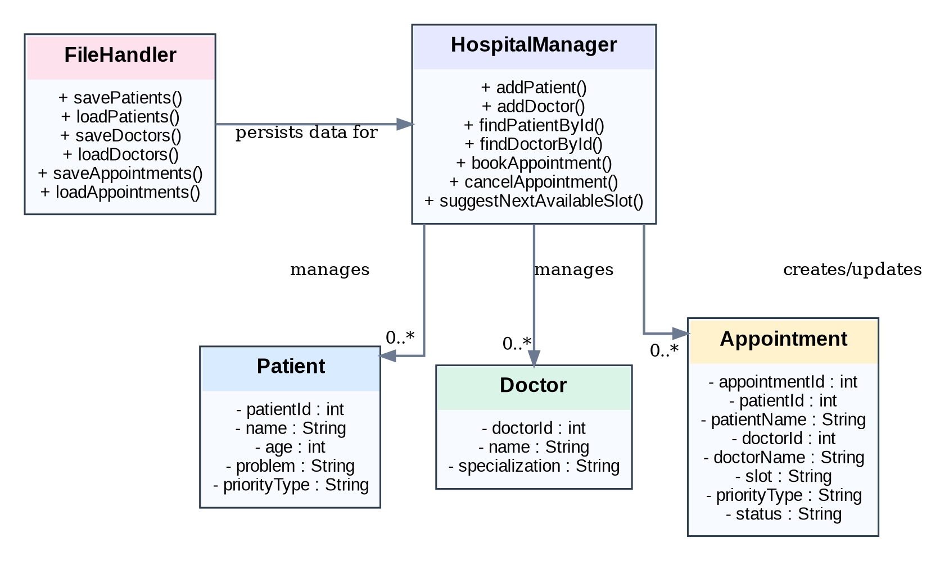
System Design
2/5
Package
structure
Console UI / Main
HospitalManager
(service logic)
Model objects
Patient / Doctor / Appointment
src/
model/
service/
util/
Main.java
Domain data used across flow
FileHandler
(text persistence)
User input + menu validation
Rules + priority decisions
save/load
CORRECTED UML CLASS DIAGRAM
Key classes & responsibilities
• Patient stores identity, age, medical issue and priority type. • Doctor stores specialization and is referenced during booking. • Appointment captures slot, linked names/IDs, priority and current status. • HospitalManager owns business rules: search, booking, rescheduling and cancellation. • FileHandler provides lightweight persistence through text files.
Interaction flow: Main collects input → HospitalManager validates rules → Appointment list updates → FileHandler saves/loads data.

Slide 3
OOP Concepts Used
3/5
ABSTRACTION
INHERITANCE
Where used
Where used
Main.java calls manager methods instead of embedding booking rules.
No explicit custom inheritance is used in the submitted code.
Why it matters
Why this is acceptable
The menu stays simple while HospitalManager hides the complex decision logic.
The project intentionally uses a flat model to stay beginner-friendly and easier to debug. A future extension could introduce a Person base class for Patient and Doctor.
POLYMORPHISM
DESIGN CHOICE / PATTERN
Where used
Applied structure
Each model class overrides toString(), and the same println(object) flow prints different object types correctly.
The project follows a lightweight layered structure: model + service + util + Main.
Why it matters
Reason
This gives one common print mechanism while each class controls its own display format.
A formal GoF pattern was avoided to keep the code readable, but responsibility separation is still clear and modular.

Slide 4
Technical Highlight
4/5
HospitalManager.bookAppointment()
DESIGN DECISION
1 Appointment existingAppointment = 2 findBookedAppointmentByDoctorAndSlot(doctorId, slot); 3 4 if (existingAppointment == null) { 5 appointments.add(newAppointment); 6 return "Appointment booked successfully."; 7 } 8 9 int newPriority = getPriorityValue(patient.getPriorityType()); 10 int oldPriority = getPriorityValue(existingAppointment.getPriorityType()); 11 12 if (newPriority < oldPriority) { 13 String nextSlot = suggestNextAvailableSlot(doctorId, slot); 14 existingAppointment.setSlot(nextSlot); 15 existingAppointment.setStatus("Rescheduled"); 16 appointments.add(newAppointment); 17 return "Higher priority patient booked."; 18 }
Chosen logic
Reschedule a lower-priority booking instead of rejecting an emergency request.
Why chosen
This makes the system realistic for hospital use, demonstrates non-trivial business logic, and still stays understandable for a beginner.
WHAT THIS SHOWS
• Conflict detection before booking a slot. • Priority comparison using a clear numeric rule. • Automatic fallback through next-slot suggestion. • Status update to Rescheduled for audit visibility. • A better demo story than simple CRUD alone.

Slide 5
Live Demo Plan
5/5
Demo script (console run)
MEANINGFUL SCENARIO
1 1) Add Doctor 2 id=101, name=Dr. Sen, specialization=General Medicine 3 4 2) Add Patient 5 id=1, name=Rahul, age=45, problem=Fever, priority=Normal 6 7 3) Book Appointment 8 appointmentId=1001, patientId=1, doctorId=101, slot=10:00 AM 9 -> Appointment booked successfully. 10 11 4) Add Patient 12 id=2, name=Anita, age=68, problem=Chest Pain, priority=Emergency 13 14 5) Book same doctor + same slot 15 appointmentId=1002, patientId=2, doctorId=101, slot=10:00 AM 16 -> Higher priority patient booked. Existing appointment moved to 11:00 AM. 17 18 6) Error case 19 appointmentId=1003, patientId=2, doctorId=101, slot=09:30 AM 20 -> Invalid slot.
• Shows one normal booking first. • Then shows why priority scheduling matters in a real hospital workflow. • The audience clearly sees automatic rescheduling, not just rejection.
ERROR HANDLING TO SHOW
• Invalid slot input returns a clear message. • Duplicate appointment IDs are rejected. • Cancelled appointments are marked, not silently deleted. • If no next slot exists, the system reports that gracefully.
Tip: during the presentation, narrate each step while typing so the examiner can connect the output to the design on slide 2 and the booking logic on slide 4.

Slide 6
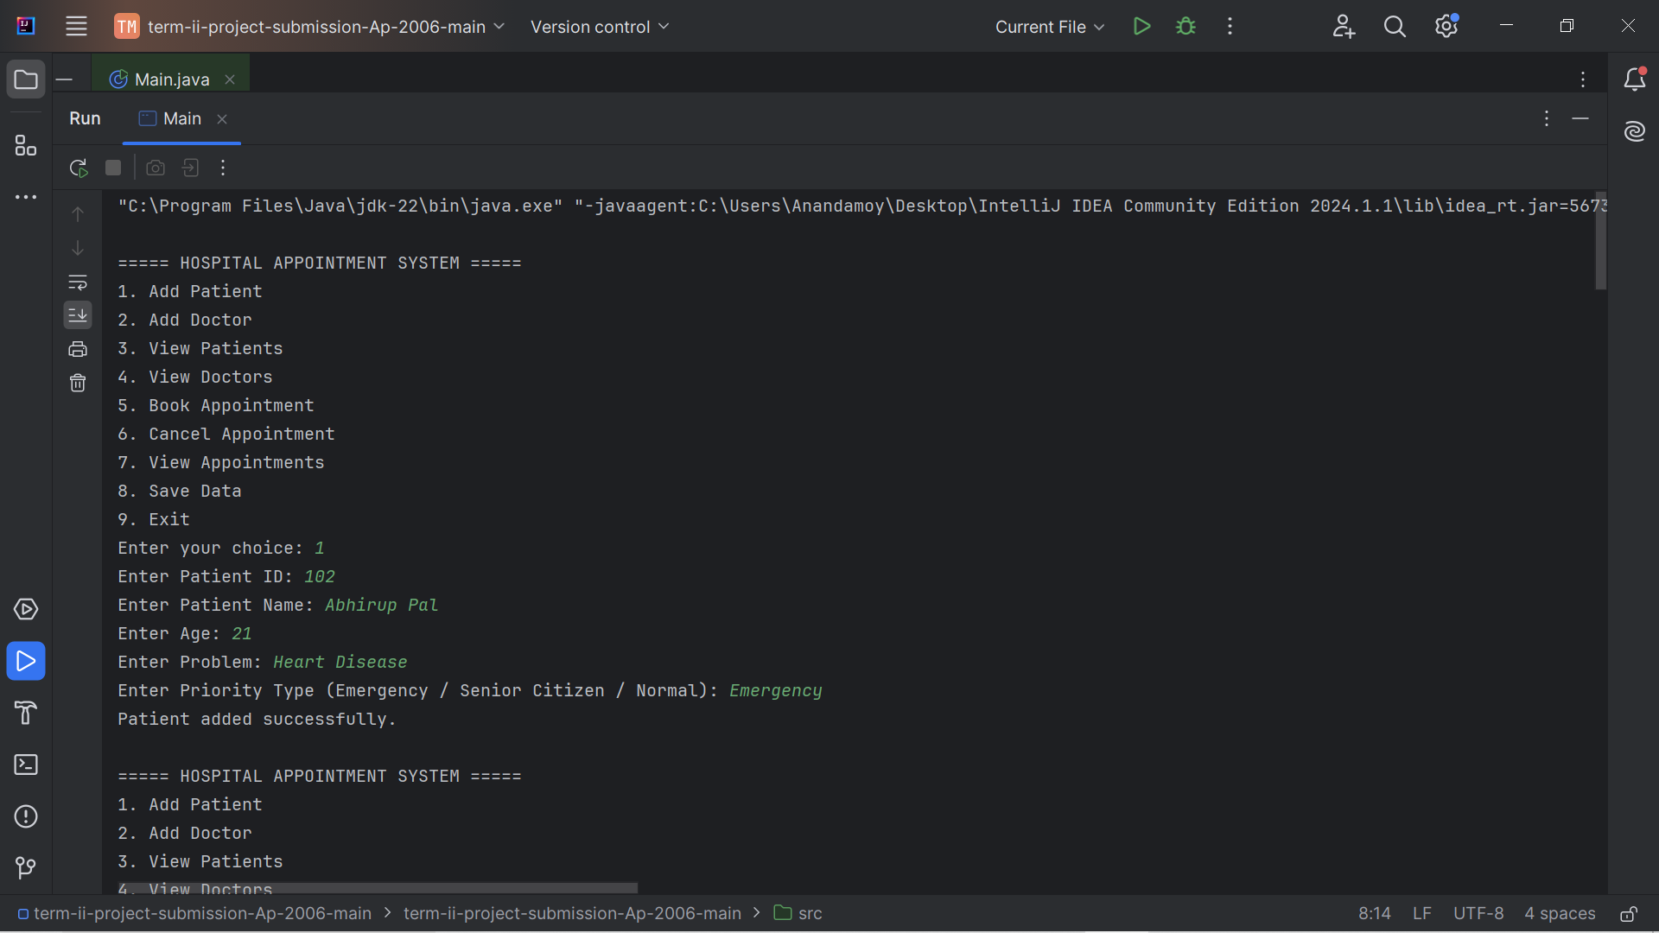

Slide 7
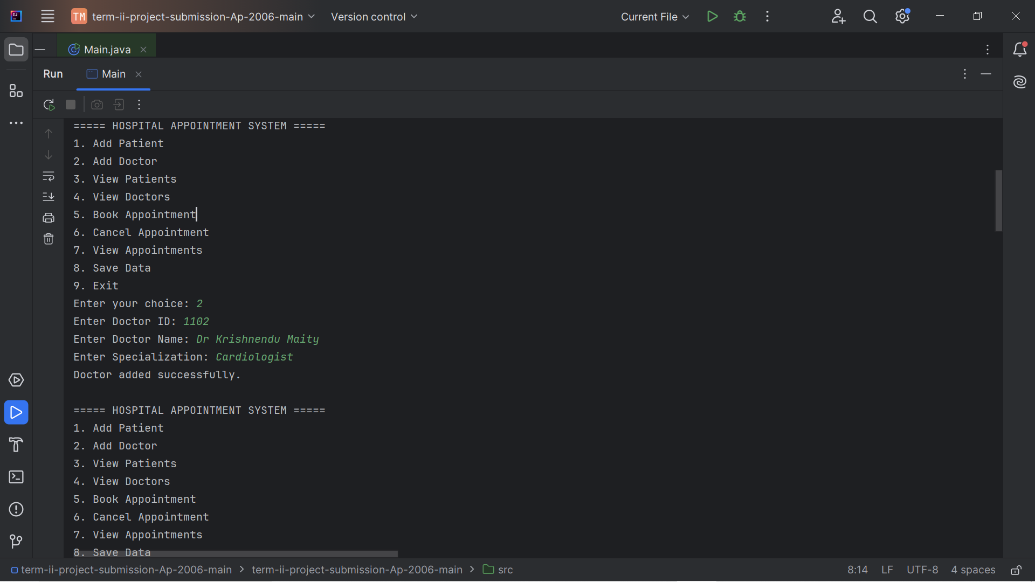

Slide 8
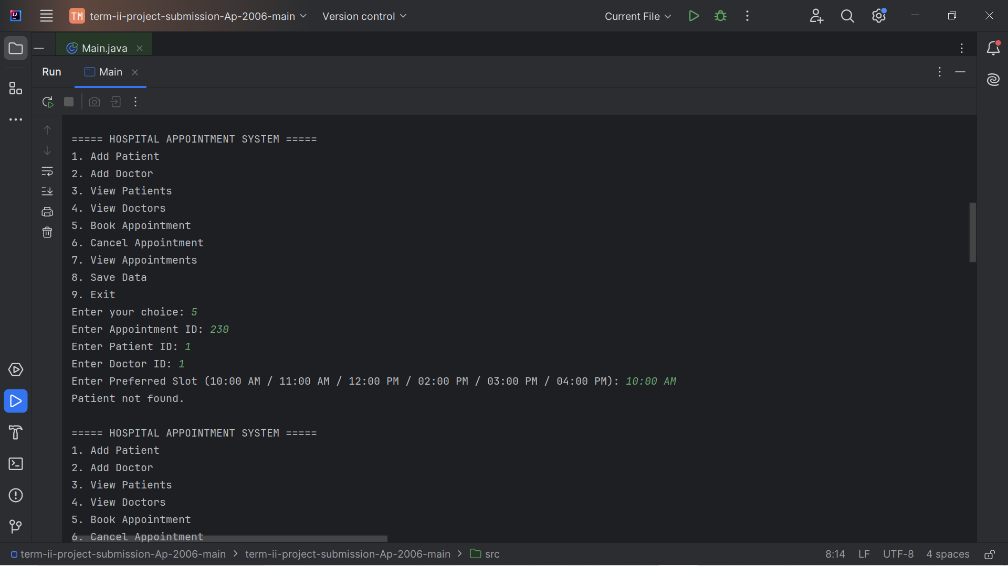

Slide 9
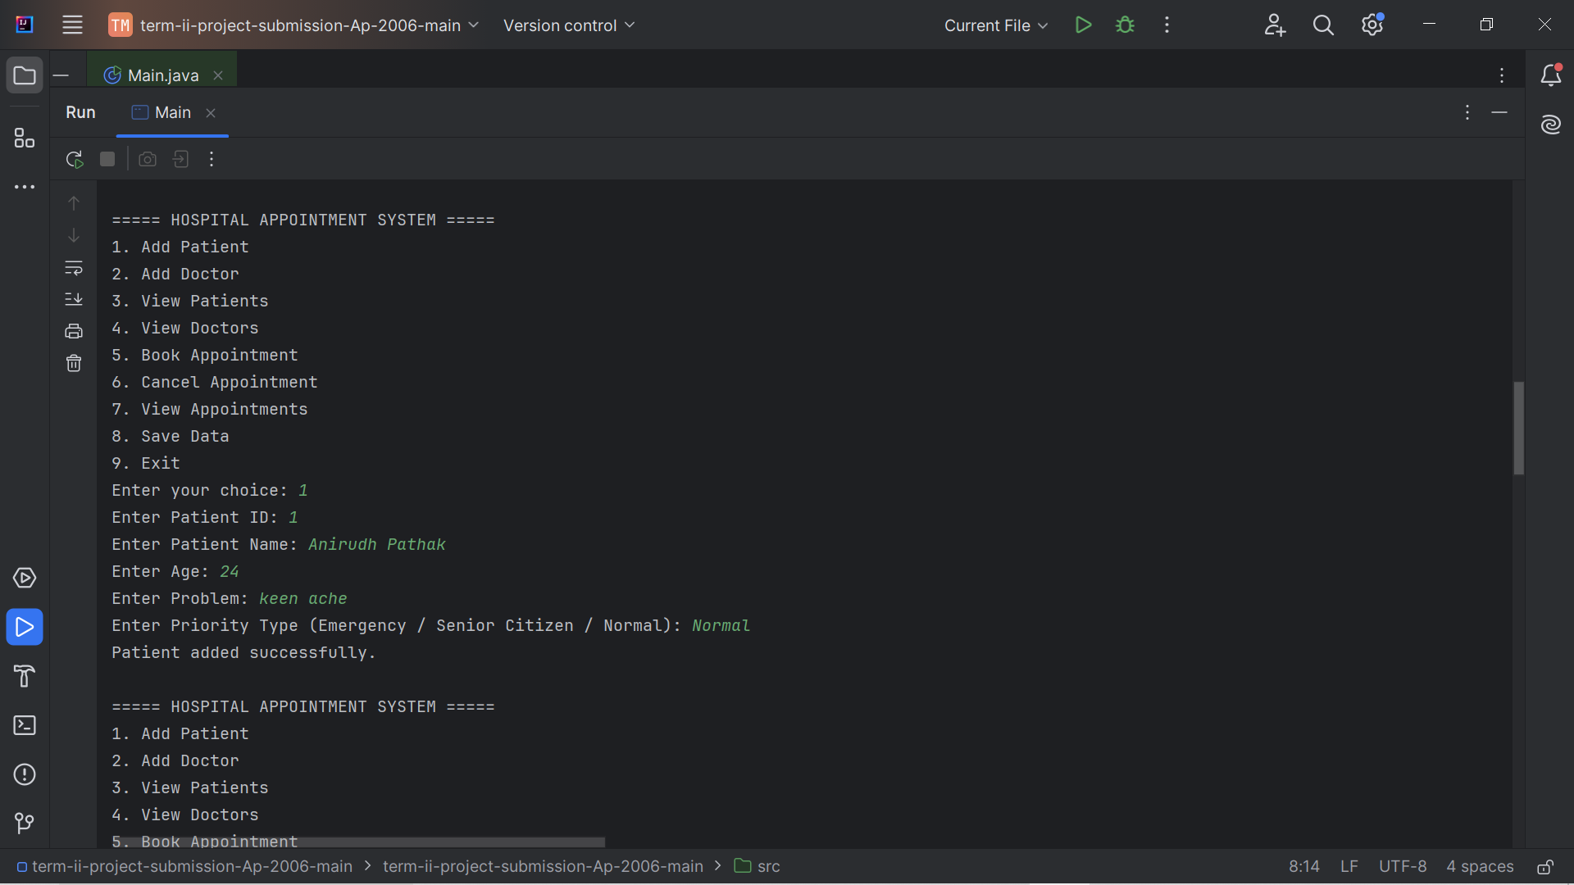

Slide 10
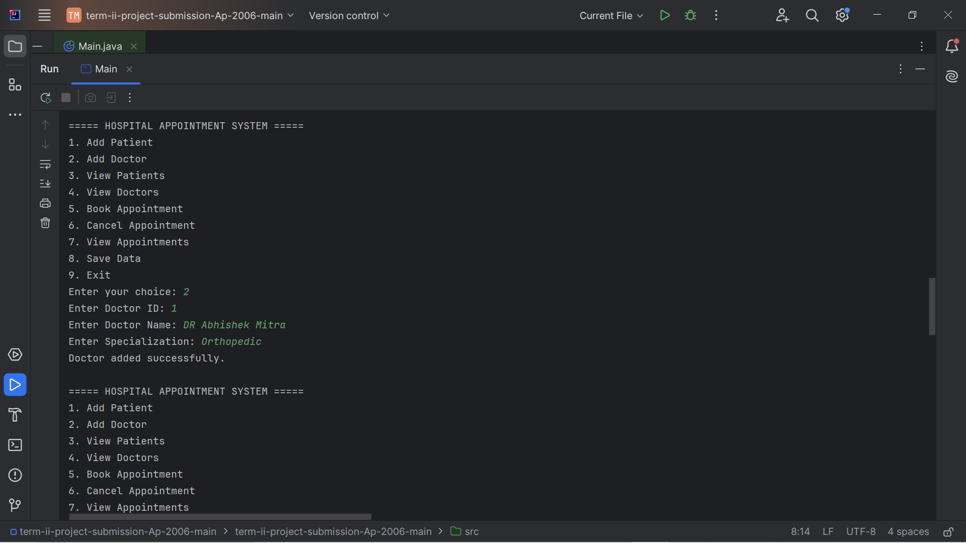

Slide 11


Slide 12
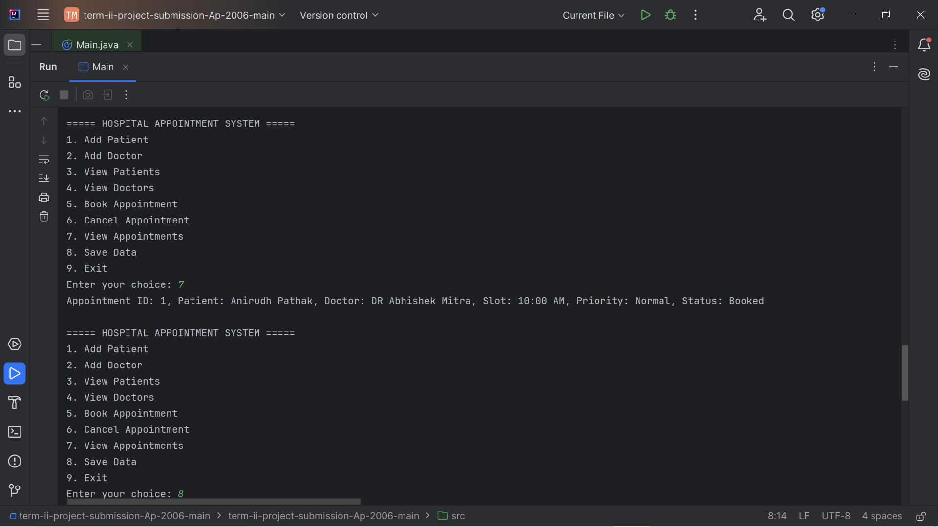

Slide 13
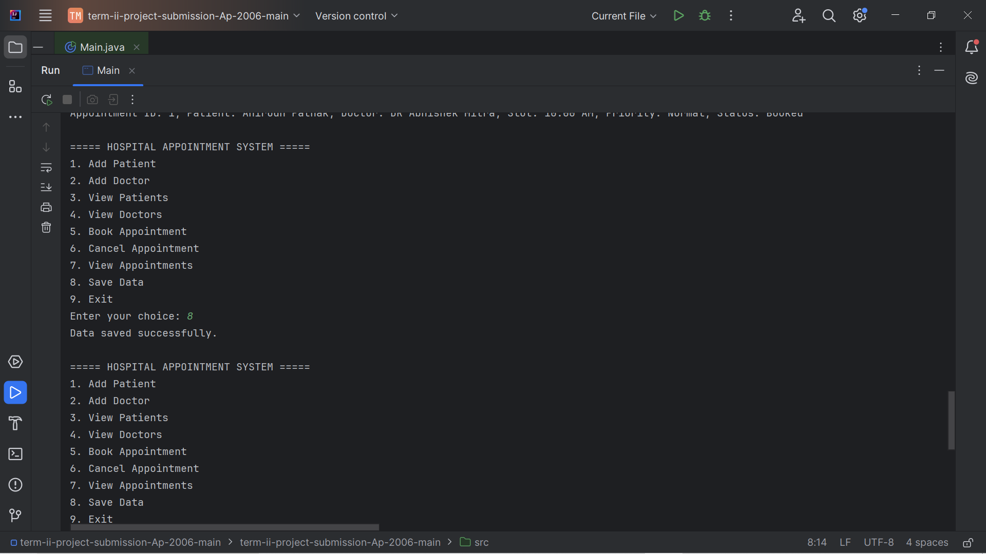

Slide 14
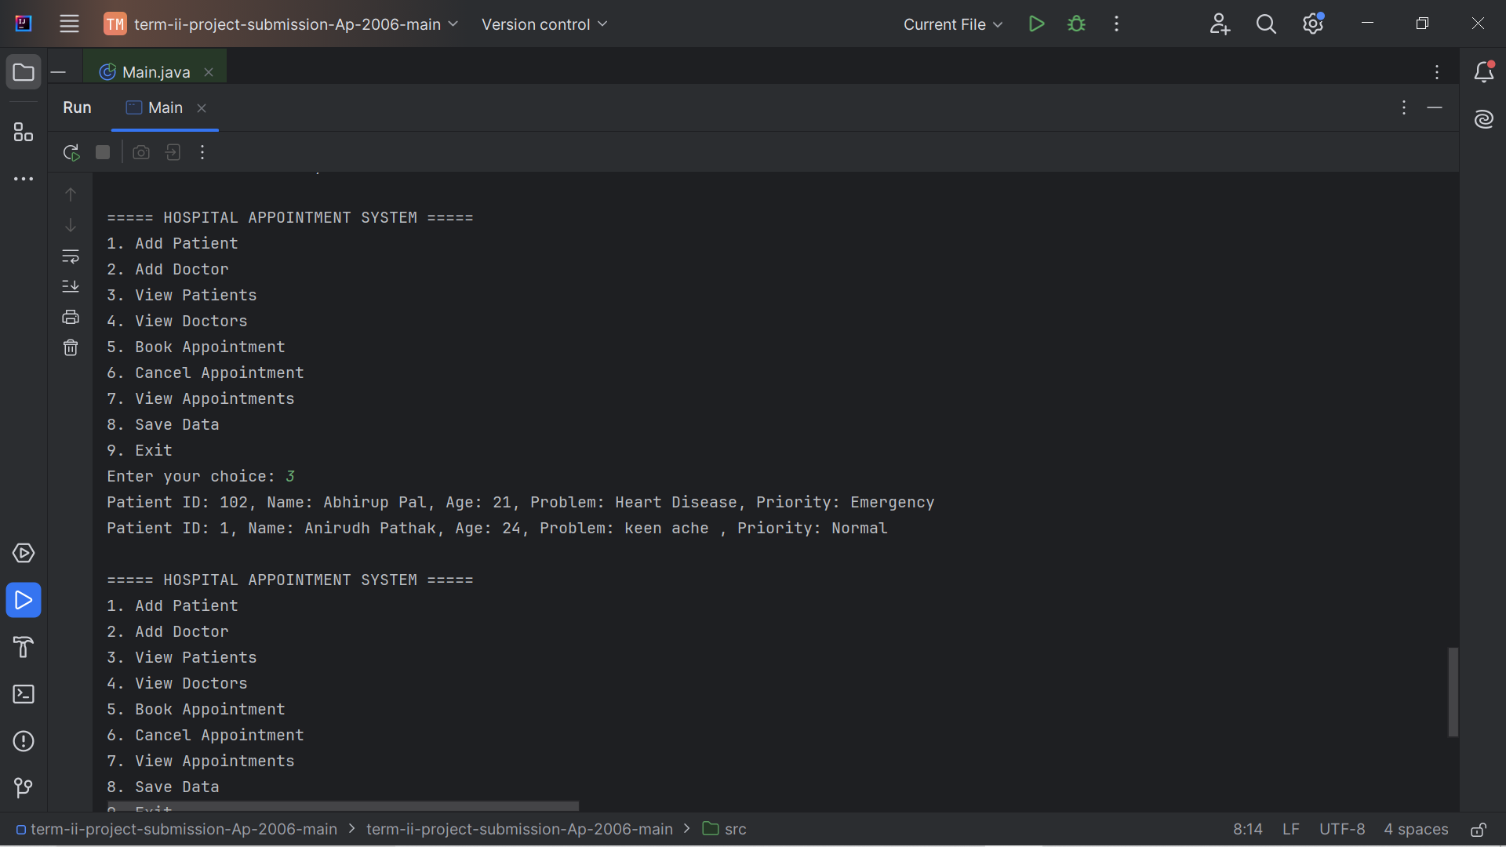

Slide 15
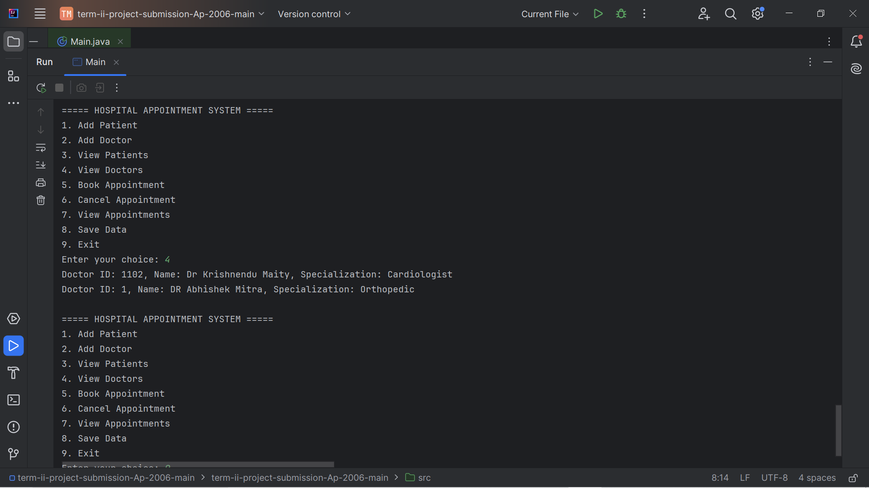

Slide 16
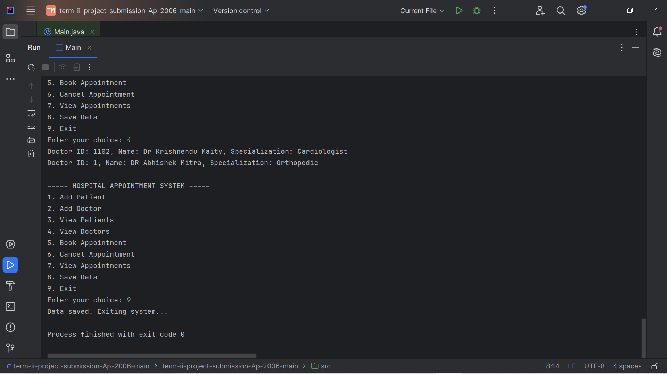

Slide 17
